Slide 1
Hotel Management System
Presented by Mohammad Abir

Slide 2
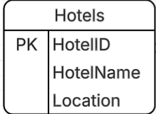
User Views
In my Project I make some tables Like: Hotel, Rooms, Employees, Guests, Bookings, BookingRooms, Services, BookingServices.
Here BookingRooms and BookingServices are bridge tables.
For “Hotels” tables we have
(HotelID, HotelName Location)
HotelID is a Primary Key.

Slide 3

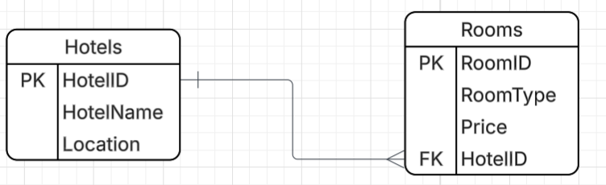
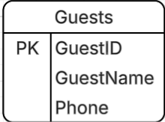
User Views
Rooms (RoomID, RoomType, Price, HotelID)
RoomID – Primary Key
HotelID- Foreign Key
Relationship : Hotel (1) – (M) Rooms.
Guests (GuestID, GuestName, Phone)
GuestID - Primary Key.

Slide 4
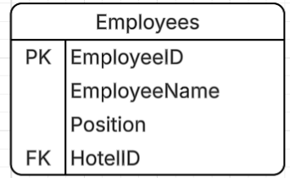
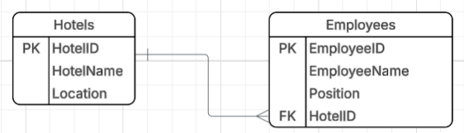
User Views
Employees (EmployeeID, EmployeeName, Position, HotelID)
EmployeeID – Primary Key.
HotelID – Foreign Key.
Relations : Hotels (1) – (M) Employees

Slide 5

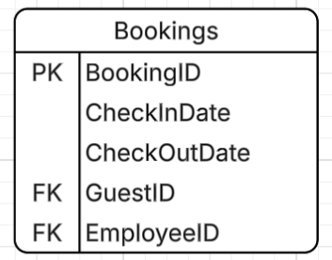


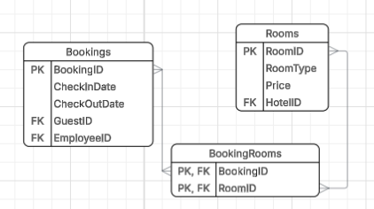

User Views
Bookings (BookingID, CheckInDate, CheckOutDate, GuestID, EmployeeID)
BookingID – Primary Key
GuestID – Foreign Key
EmployeeID –Foreign Key.
Relations : Guests(1) – (M) Bookings
Employees (1) – (M) Bookings
BookingRooms (BookingID, RoomID
FK BookingID → Bookings
FK RoomID → Rooms.
This is Many to many Bridge.

Slide 6
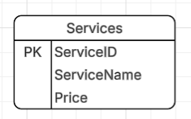
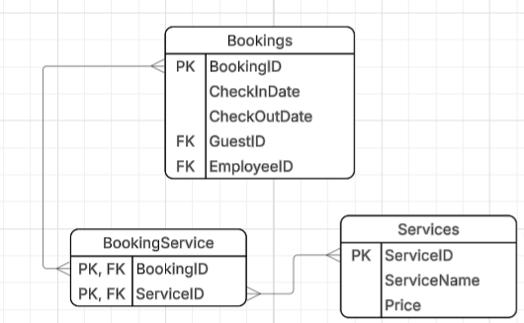
User Views
Services (ServiceID, ServiceName, Price)
ServiceID- Primary Key
BookingServices (BookingID, ServiceID)
BookingID – Foreign Key
ServiceID – Foreign Key.
This is Many to many Bridge.

Slide 7
DBDL- Database Design Language
Hotels ( HotelID, HotelName Location)
Rooms (RoomID, RoomType, Price, HotelID)
FK HotelID → Hotels.
Guests (GuestID, GuestName, Phone)
Employees (EmployeeID, EmployeeName, Position, HotelID)
FK HotelID → Hotels.
Bookings (BookingID, CheckInDate, CheckOutDate, GuestID, EmployeeID)
FK GuestID → Guests,
FK EmployeeID → Employees.
BookingRooms (BookingID, RoomID)- [BridgeTable between Bookings and Rooms]
FK BookingID → Bookings
FK RoomID → Rooms.

Slide 8
DBDL- Database Design Language
Services (ServiceID, ServiceName, Price)
BookingServices (BookingID, ServiceID)- [BridgeTable between Bookings and Services]
FK BookingID → Bookings
FK ServiceID → Services.

Slide 9
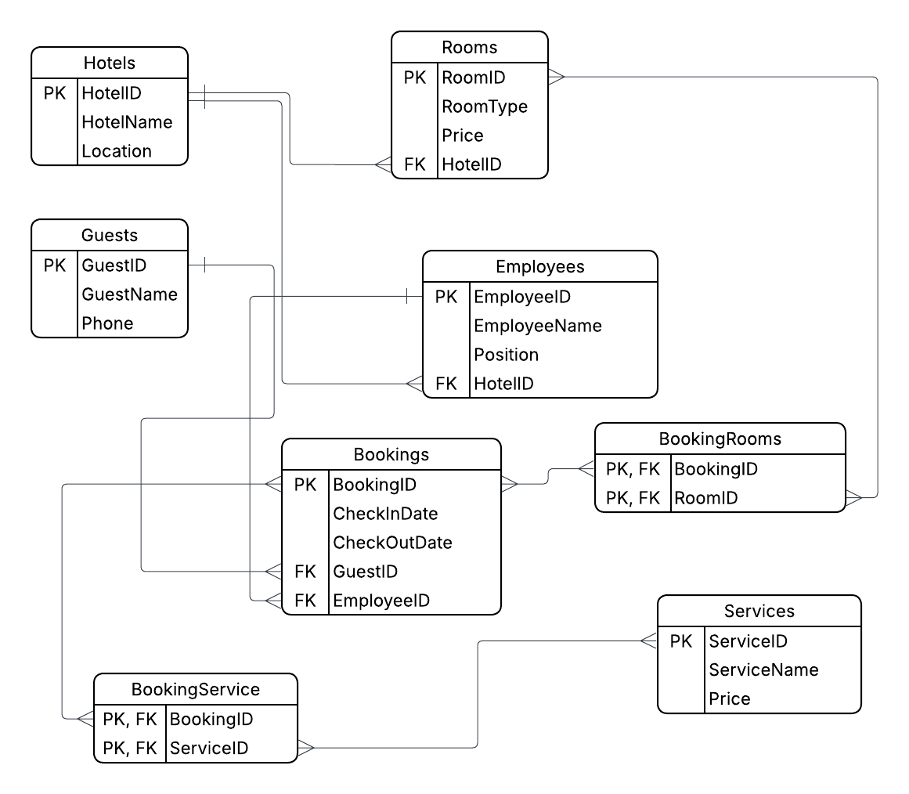
ERD- Entity-Relationship Diagram

Slide 10
Conclusion
The System model real Hotel operations.
Supports multiple rooms and services per booking.
Uses proper Primary and Foreign Key relationships.

Slide 11
Thank You

